Slide 1





MUSIC STORE ANALYSIS
USING
SQL PROIECT
By
Mugilan K S

Slide 2



Objectives
Gain insights into customer behavior and purchasing patterns within the music store.
Analyze music sales trends and identify best-selling genres and artists
Identifying exceptional artists based on composition, track duration, or genre focus.
Analyzing albums with unusually high or low track counts while considering influencing factors.

Slide 3
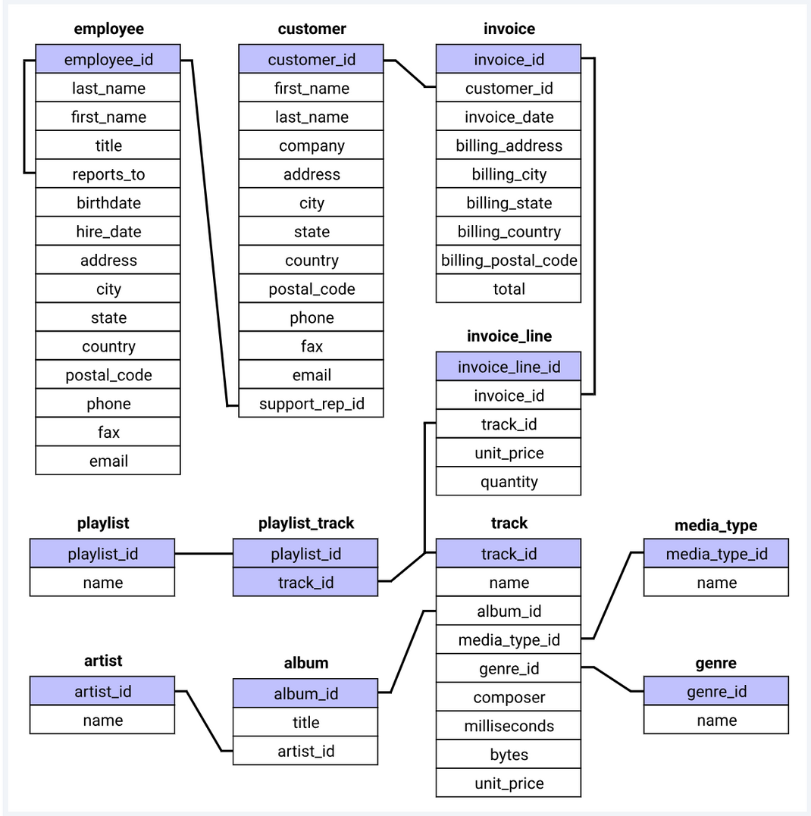
Database
schema

Slide 4
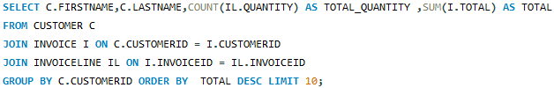
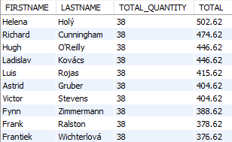
Customer Analysis
1.Who are the top 10 spending customers, showing their total purchase amount and number of purchases?

Slide 5
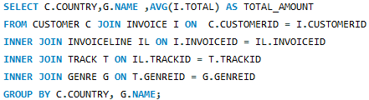
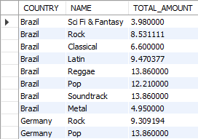
2.What is the average amount spent on each music genre, broken down by customer country?

Slide 6
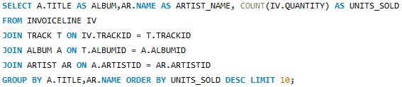
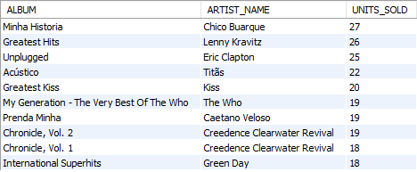
Sales Analysis
3.What are the top 10 best-selling albums of all time, showing album title, artist name, and total units sold?

Slide 7
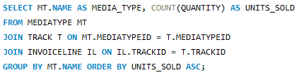
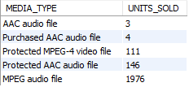
4.Find the media formats with the least number of units sold overall.

Slide 8
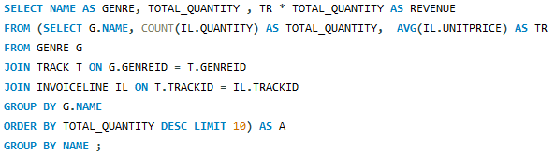
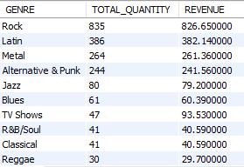
5.Identify the most popular genre (by units sold) across all sales in the Chinook database. Additionally, calculate the total revenue generated by this genre.

Slide 9
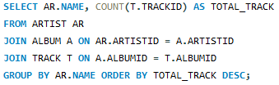
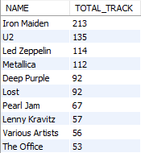
Artist & Track Analysis
6.Who are the top artists with the most tracks in the database? Show artist name and total number of tracks for each artist.

Slide 10
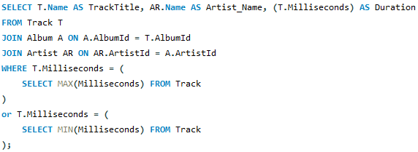
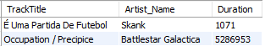
7.What are the tracks with the longest and shortest durations? Show track title, artist name, and duration (in milliseconds) for each.

Slide 11
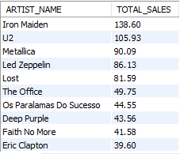
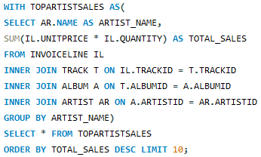
8.What are the top 10 artists with the most total sales.Show artist name and total sales amount

Slide 12
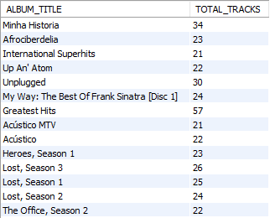
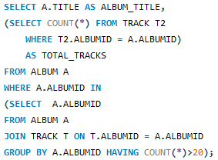
9.What are the albums containing more than 20 tracks? Show information like album title, number of tracks.

Slide 13




Thank You

